Slide 1
2024-02-21
SEM-03
Deposition amount
Samples I, J, and K
(sample L did not go well, no visible Li deposition)

Slide 2
Sample I (0.005 mAh cm-2)

Slide 3
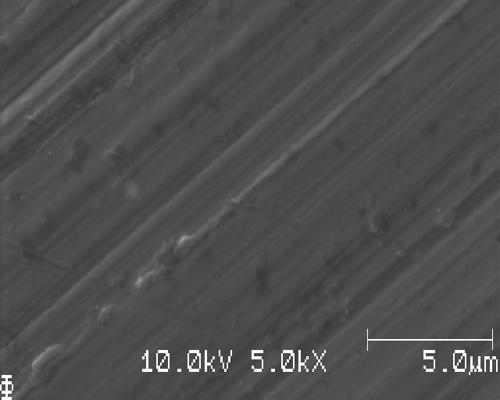
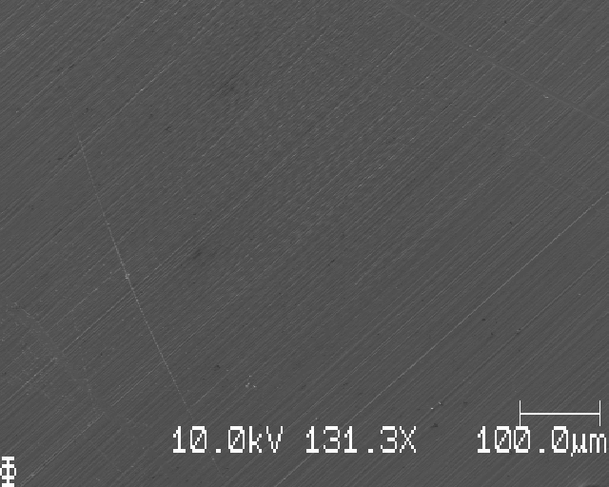
Polished Cu (no Li) close to edge

Slide 4
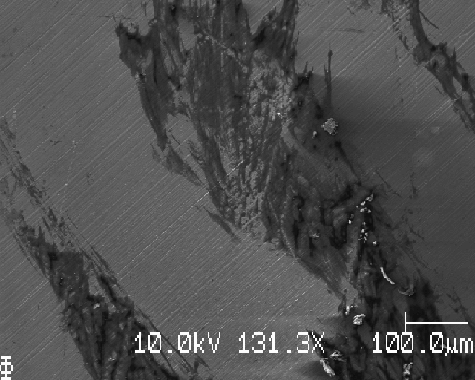
Closer to middle, probably salt/skrap

Slide 5
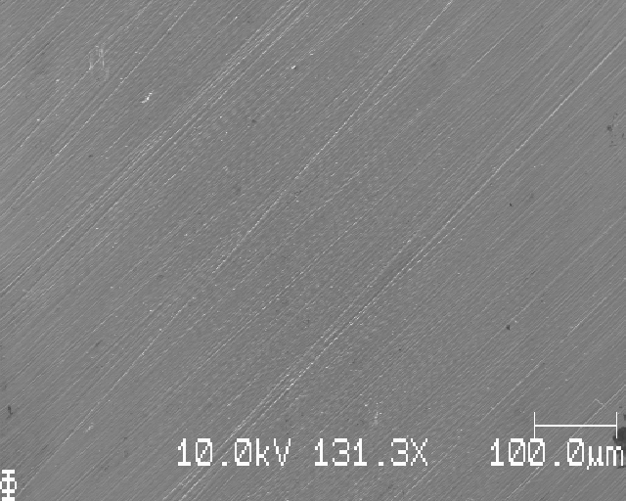
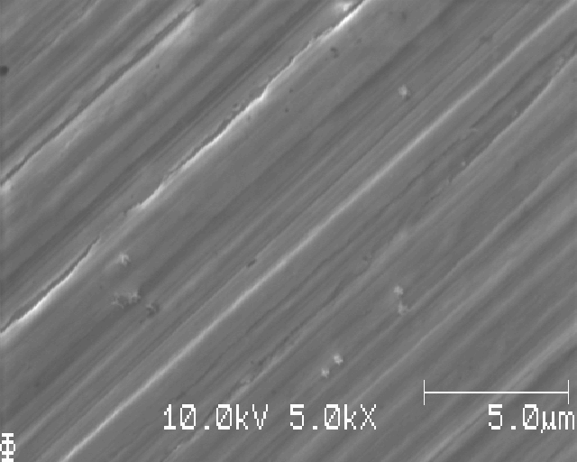
Closer to middle, might be Li (very small, very sparse)

Slide 6
No signs of blatant Li deposition on sample I

Slide 7
Sample J (0.01 mAh cm-2)

Slide 8
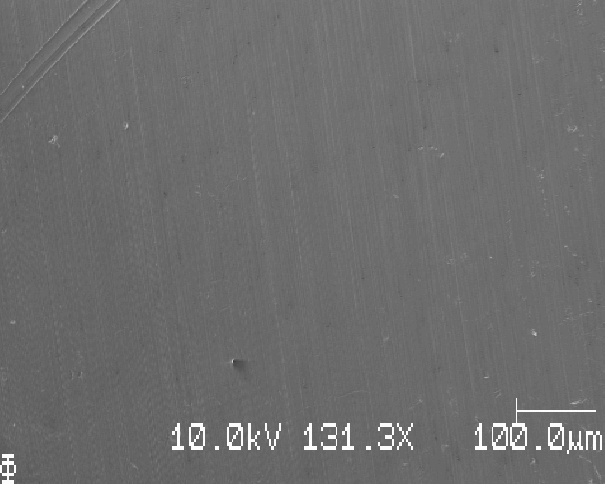
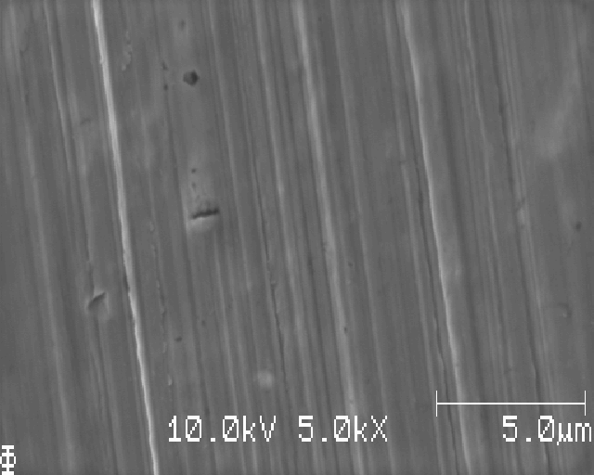
2mm from edge

Slide 9
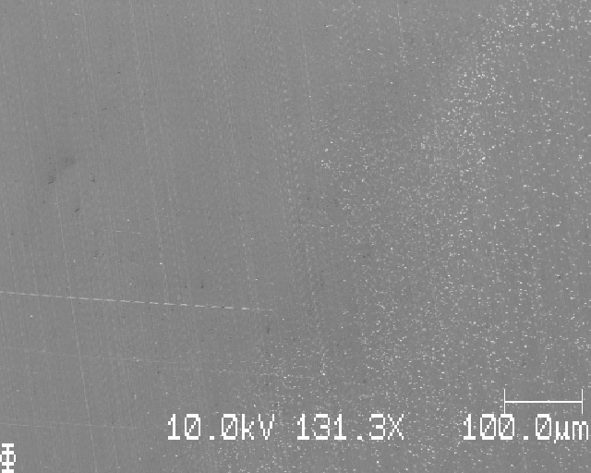
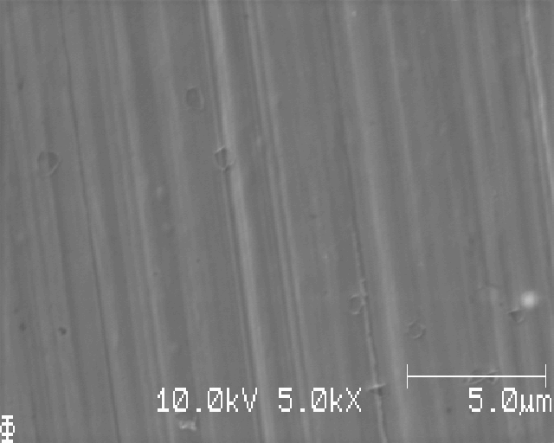
Edge of deposition (EOD)

Slide 10
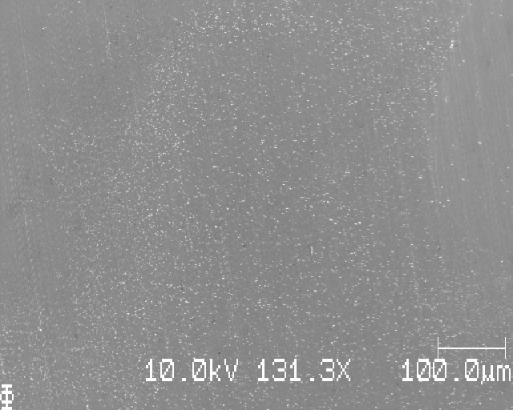
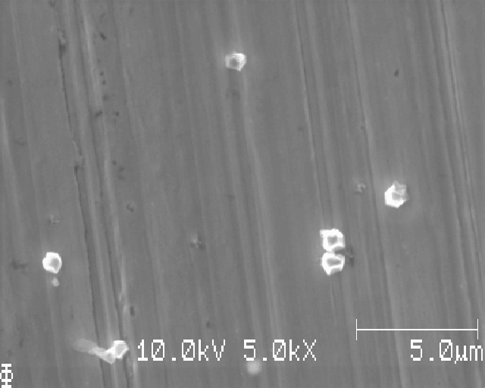
Middle of the band (annulus) of deposition

Slide 11
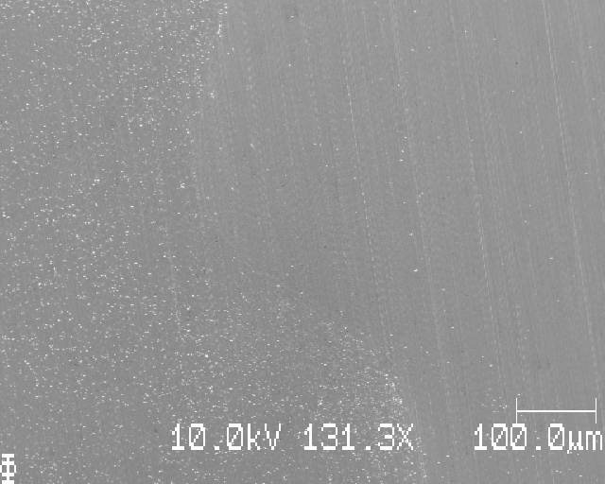
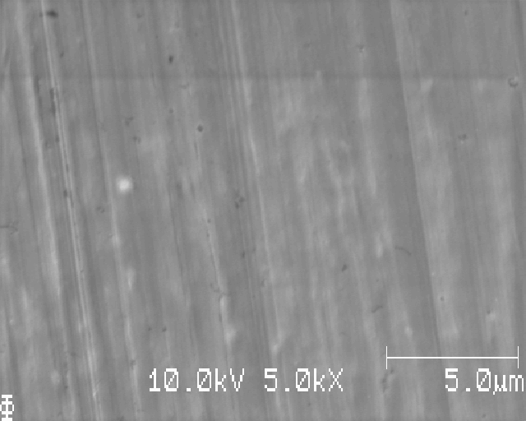
Closer to middle (band of deposition to the left now)

Slide 12
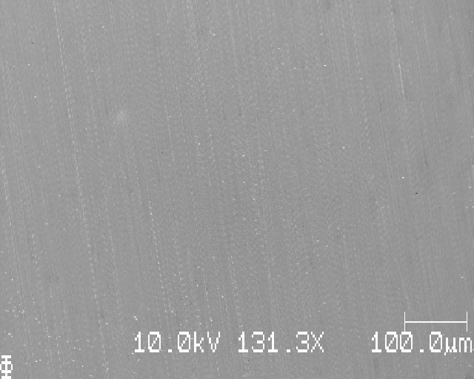
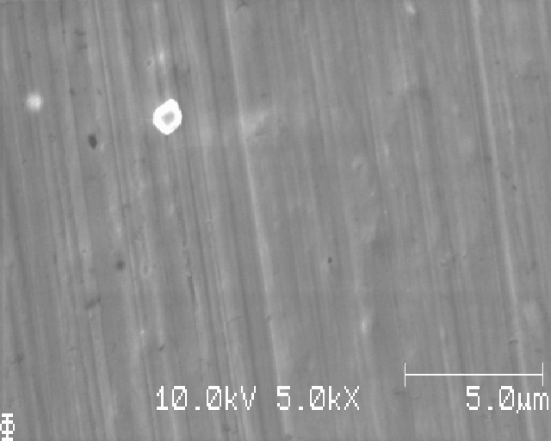
Eye of the storm, middle of annulus

Slide 13
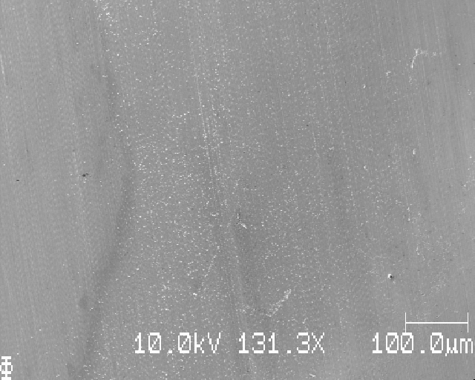
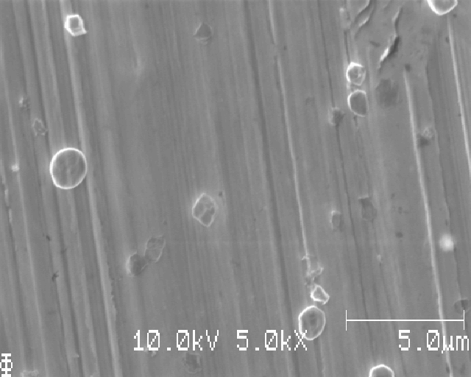
Right part of annulus deposition

Slide 14
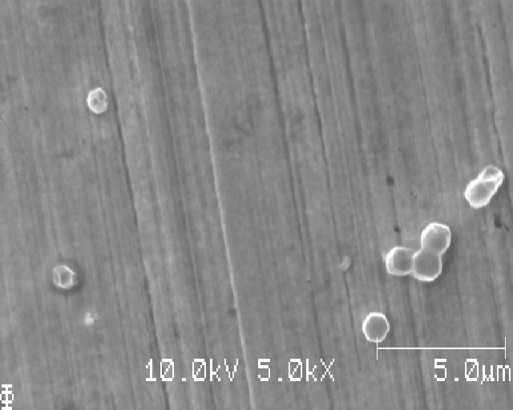
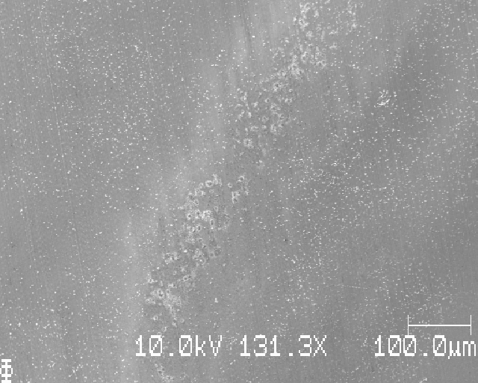
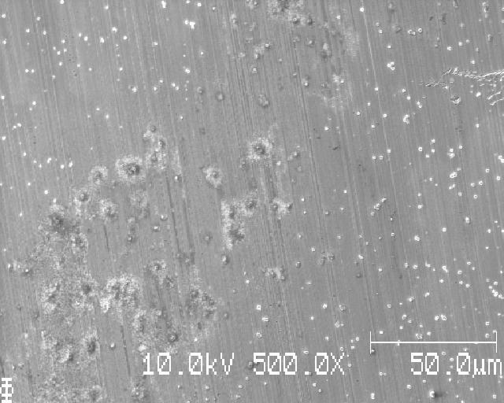
Lower right part of annulus

Slide 15
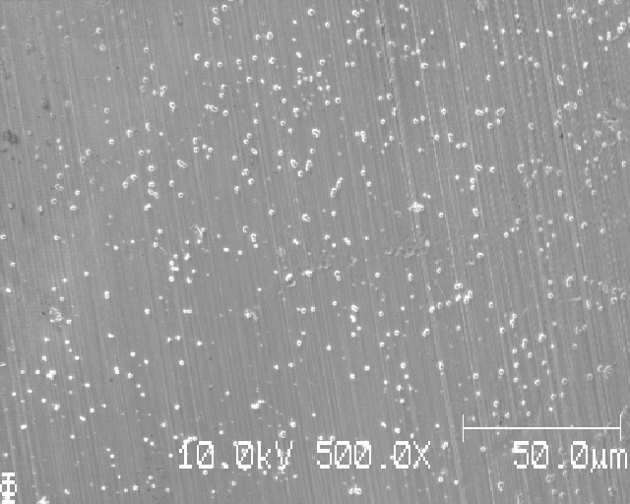
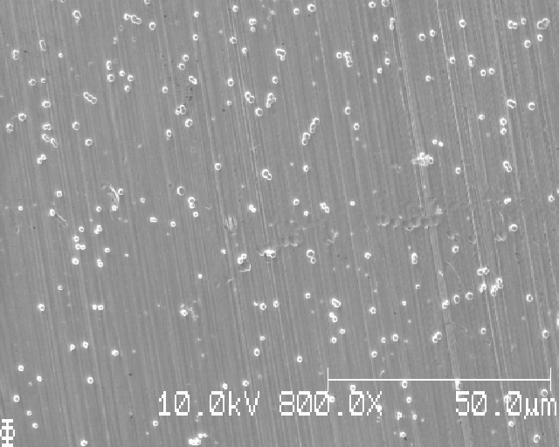
Lower part of annulus, different magnifications (test ImageJ analysis)

Slide 16
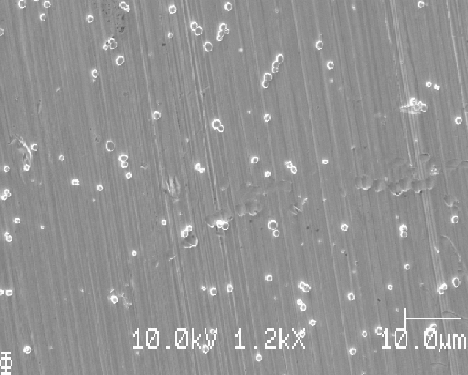
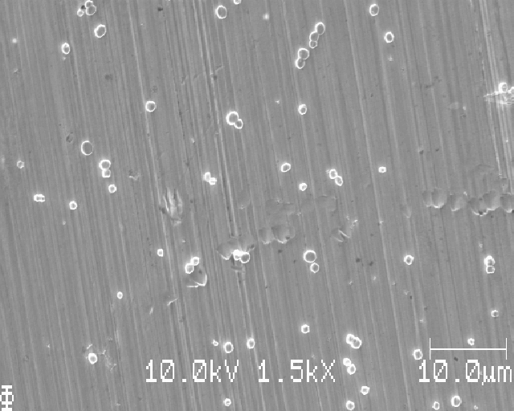
Lower part of annulus, different magnifications (test ImageJ analysis)

Slide 17
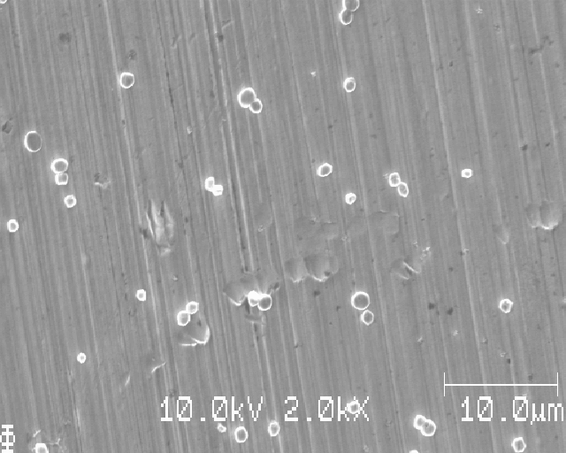
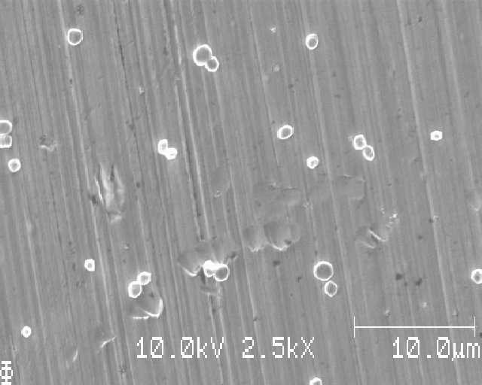
Lower part of annulus, different magnifications (test ImageJ analysis)

Slide 18
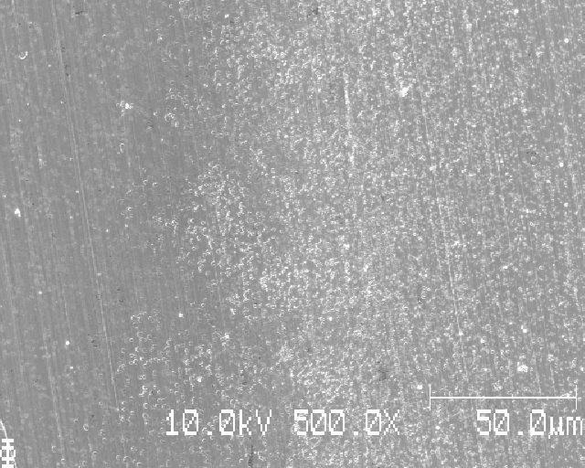
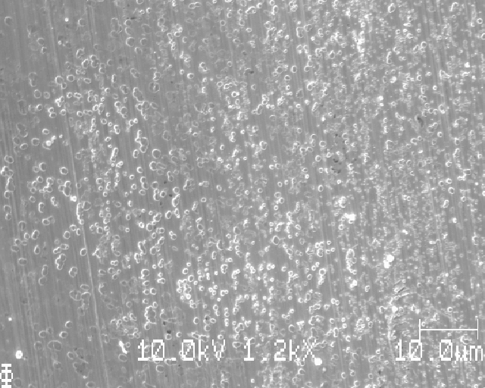
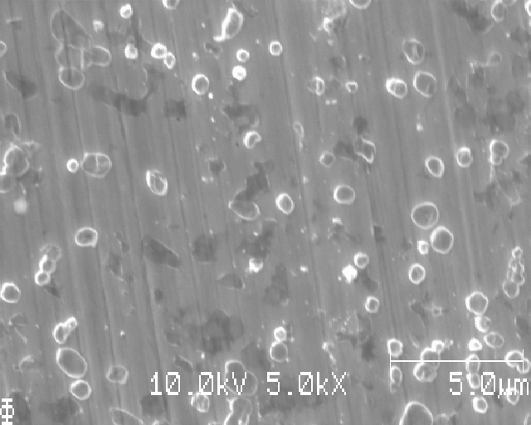

Slide 19
Sample J:
clear Li deposition
nuclei approx. 1 micrometer in diameter
Deposition region is an annulus following the circumference of the 5 mm Li disk used for deposition

Slide 20
Sample K (0.025 mAh cm-2)

Slide 21
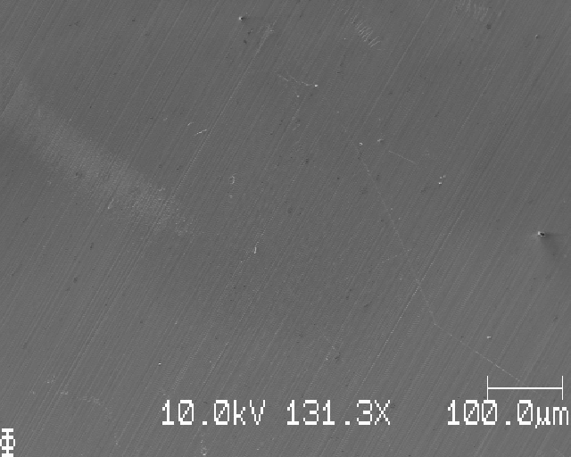
1mm from edge

Slide 22
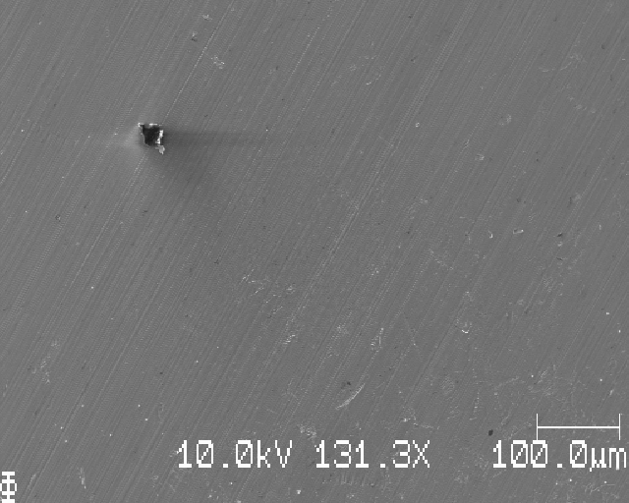
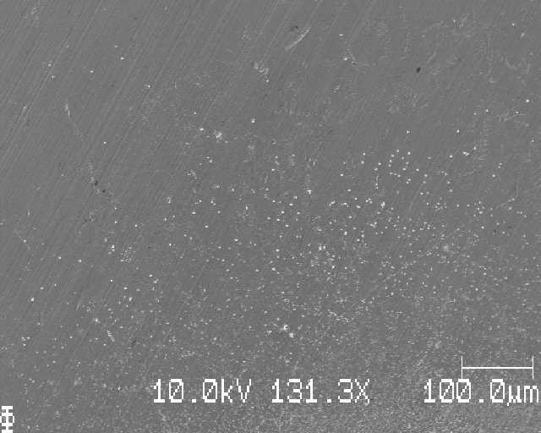
2mm from edge

Slide 23
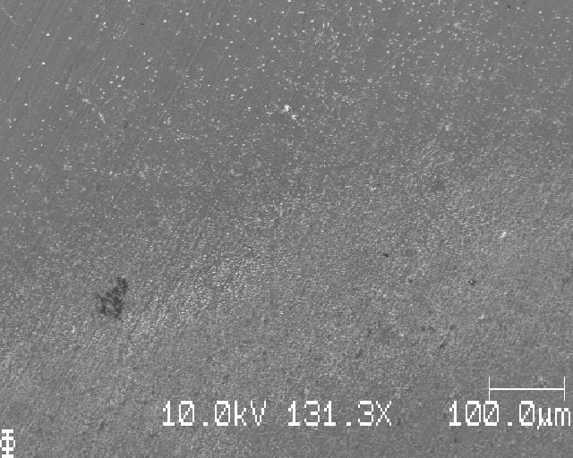
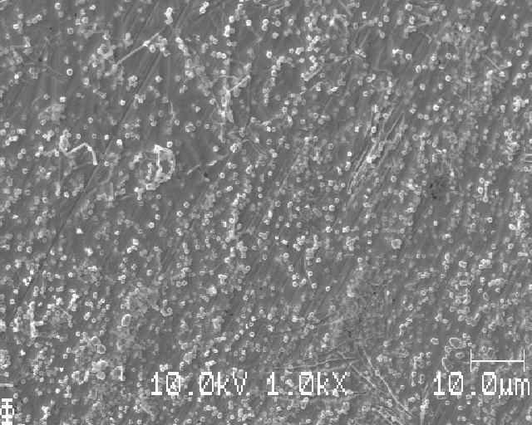
EOD, approx. 2,5 mm from edge of sample

Slide 24
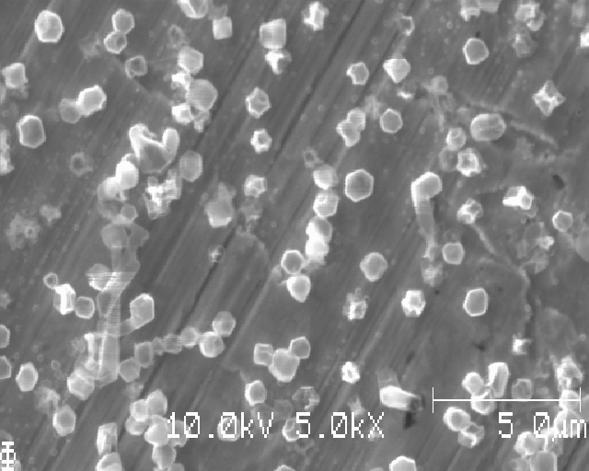
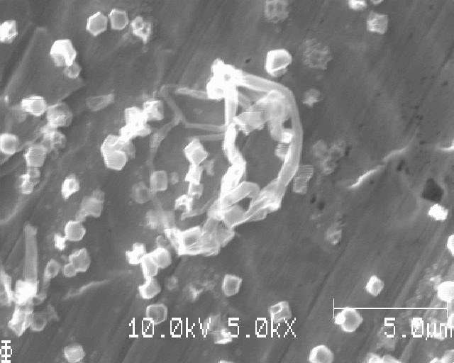

Slide 25
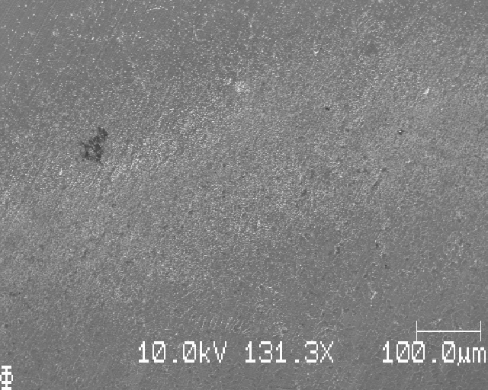
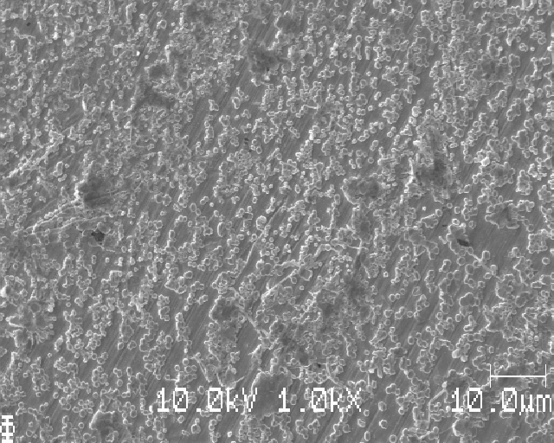
Inner radius of EOD

Slide 26
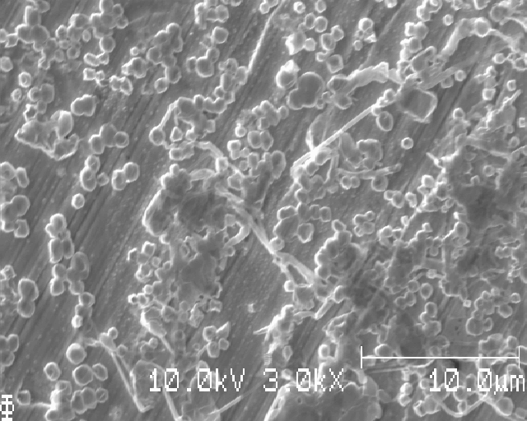

Slide 27
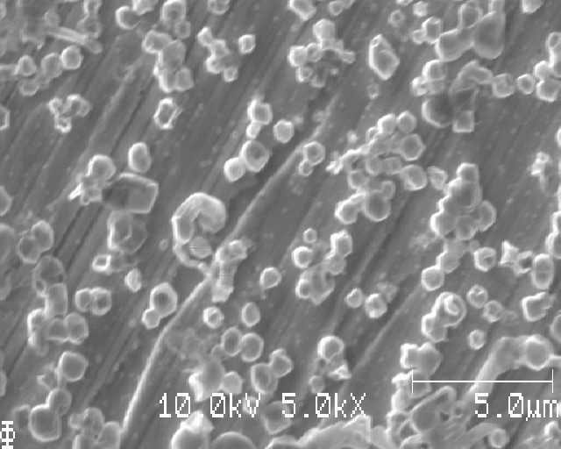
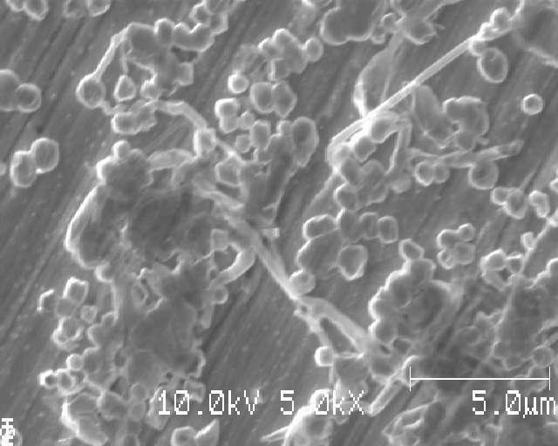

Slide 28
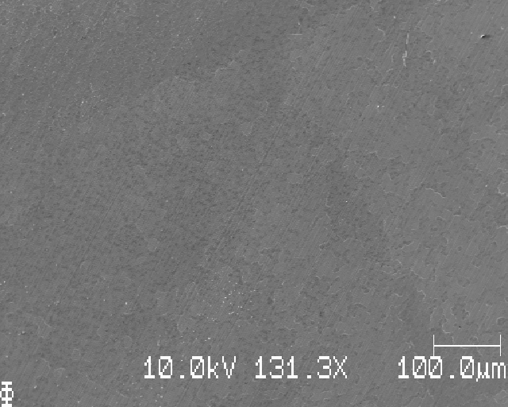
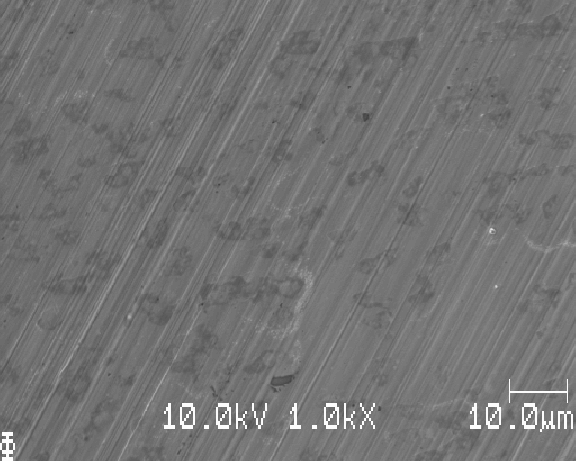
Eye of the storm, middle part, little Li

Slide 29
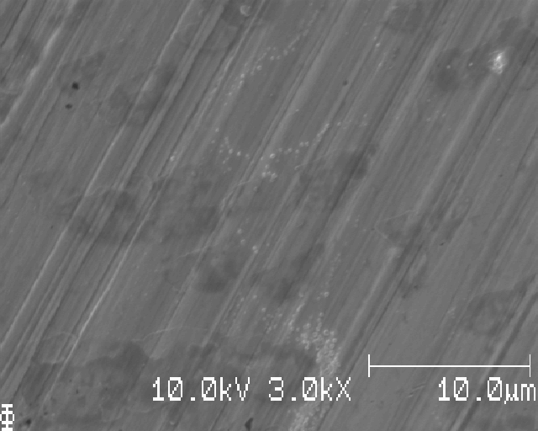
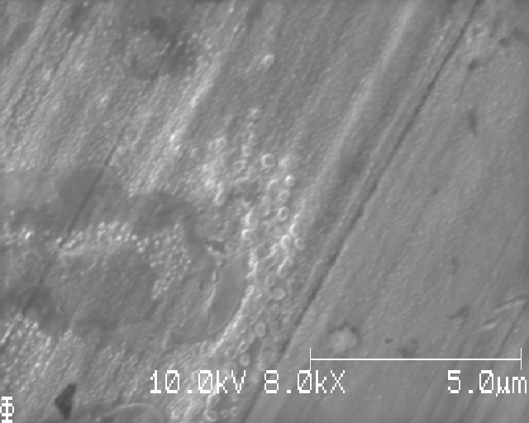

Slide 30
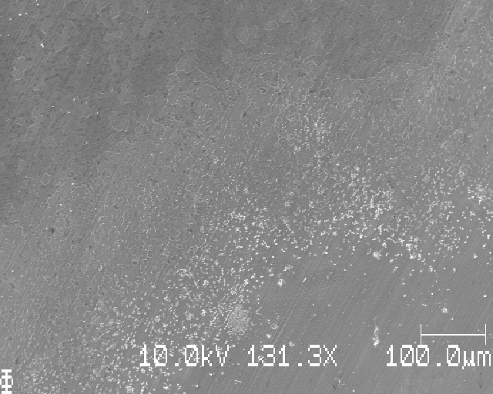
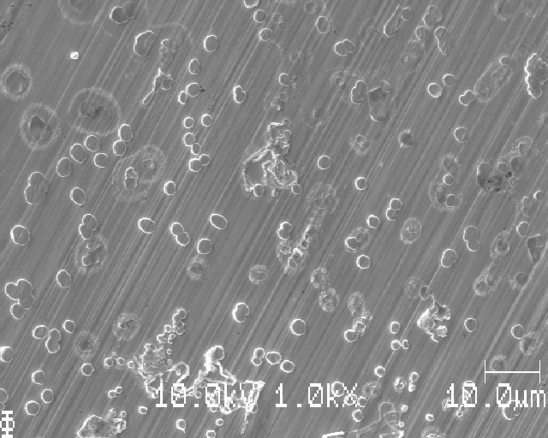
Lower part of upper deposition band (note rings, ‘halo’s around dead? Li nuclei)

Slide 31
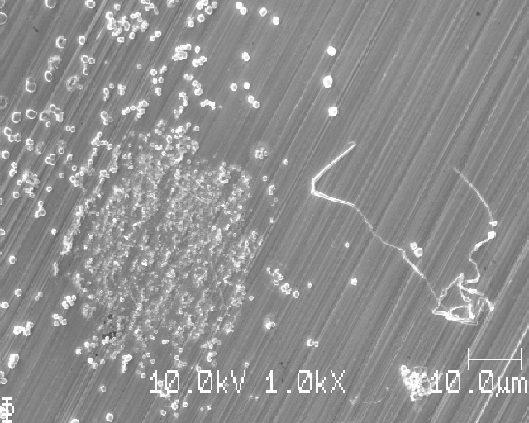
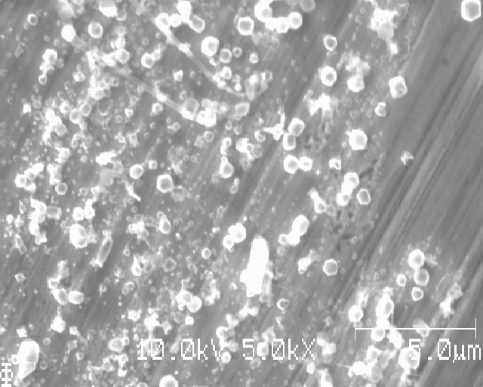

Slide 32
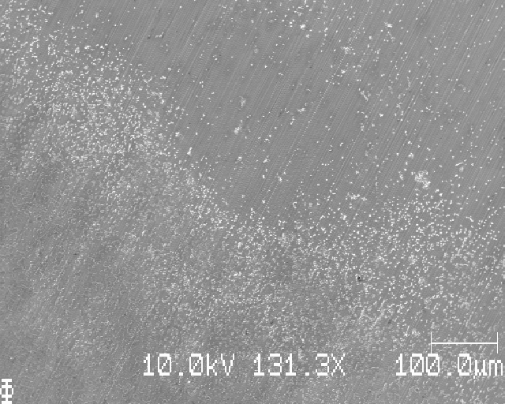

Upper part of lower deposition band

Slide 33


Middle part of lower deposition band

Slide 34


Lower part of lower deposition band

Slide 35


Lower edge of lower deposition band

Slide 36

Below lower edge

